Slide 1
Passwords
By Mr S Karunaratne
CAS Newent Hub

Slide 2
Learning objectives:
To create a secure password

Slide 3
Why do we have passwords?
What are the common passwords that people use?
111111
QWERTYUIOP
ZXCVBNM
1Q2W3E4R
1234546

Slide 4
How can people have secure passwords?
How are passwords cracked?
Next Met Police video on passwords

Slide 6
Task:
Using your word processing software, can you think of things/ items/ objects that can make up your 3 categories for your password?
e.g. Food, transport, animal
Now make 3 passwords using your categories

Slide 7
Task continue:
What can you add to make it more secure?
Would someone who knows you be able to guess your password?
Have you added any numbers or special characters?

Slide 8
Testing your password:
Choose your ‘best’ password, the one you are most likely to remember
Ask your teacher to test it using a website that checks your password and how secure it is: https://howsecureismypassword.net/

Slide 9
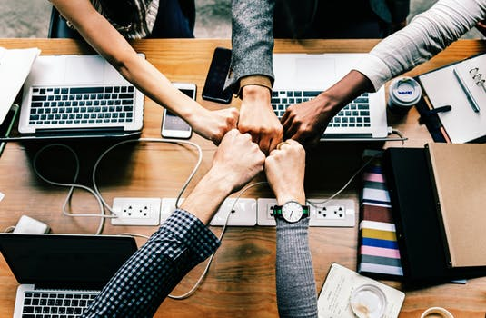
Plenary:
How good was your password?
Should you tell your friends your password?
How often should you change your passwords?

Slide 10
I would like to thank the following contributor: The Metropolitan Police for use of their video

